Slide 1
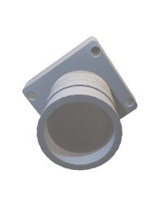
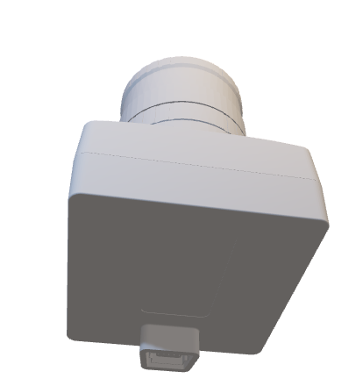
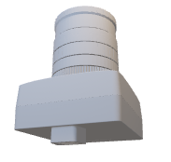
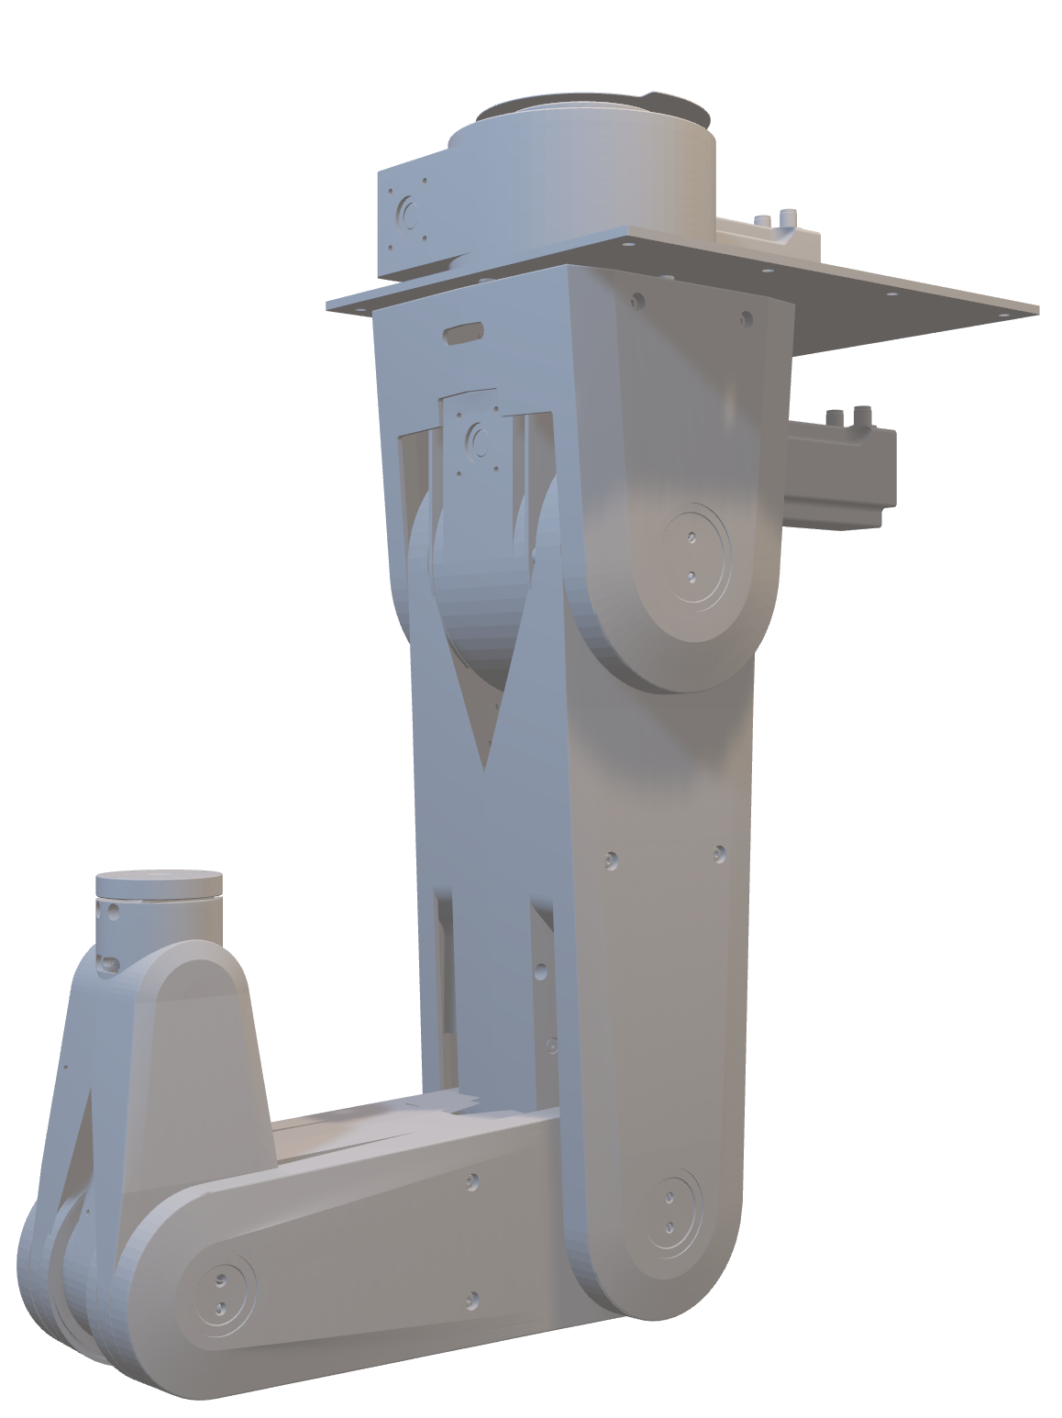
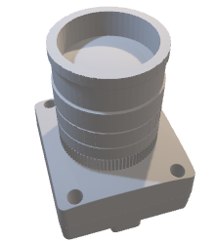
Calibration error
Lens
Diffractive Optical
Element
Temperature
warping
Dynamic
flexion
Multiplied Marker Positions in
Image Plane
Joint position
variance
External
measurement system
Notes:
To compensate for flexion, warping and calibration we propose a novel external measurement system.
However this is not the focus for today, Hut a different publication
Instead I want to focus on the joint position variance error since this cant be compensated this way
Desired precision 5 micrometer -> like going from quality 1 to quality 2

